Slide 1
Project Title:Stock Price Prediction using Machine Learning
Team members
Enes Garip 150116034,
Mustafa Sertaç Öztürk 150116078,
Tunahan Aydın 150114074

Slide 2
Contents
What is Stock Price Prediction?
Goal of Stock Price Prediction
Advantages and Disadvantages
Recurrent Neural Networks
Long Short Term Memory Networks
Dataset and Dataset Format
Train Data information
Training Model Loss
Stock Price Prediction
Summary
Task Sharing
References

Slide 3
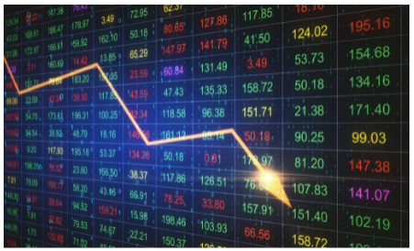
What is Stock Price Prediction?
The term stock price refers to the current price that a share of stock is trading for on the market. The price of a stock will go up and down in relation to a number of different factors.
Stock Price Prediction using machine learning helps us to find the value of your company's future stock and other financial goods traded on the stock.
It is based on statistical and econometric models.
Effective market hypothesis tells us stock price shows all available information.
The entire idea of predicting stock prices is to gain significant profits.So, the successful prediction of a stock's future price could yield significant profit . Predicting the stock market with high accuracy is a hard task to do.

Slide 4
Stock prices change everyday by market forces.This stock price will go up and down in relation to a number of different factors. By this we mean that share prices change because of supply and demand. If more people want to buy a stock (demand) than sell it (supply), then the price moves up. Conversely, if more people wanted to sell a stock than buy it, there would be greater supply than demand, and the price would fall.
Stock price prediction is a task full of challenge. However in order to make profits or understand the
essence of equity market, numerous market participants or researchers try to forecast stock price
using various statistical , econometric and different algorithms.

Slide 5
Goal of Stock Price Prediction
•It is important that predicting the stock price will help us to calculate and find profit.
•What makes people like a particular stock and dislike another stock. This comes down to figuring out what news is positive for a company and what news is negative.
•To find out if a stock's price has risen or fallen.
•To keep records about stock price by stock price algorithm.
•The entire idea of predicting stock prices is to gain significant profits.
•Visualize the predicted stock costs with actual stock costs:

Slide 6
Advantages
Disadvantages
1)The stock market has the characteristics of high return which has attracted the majority of investors.
2)Reducing unnecessary assets’ losses.
3)It is very helpful for companies.
4)It generates personal richness.
5)Stock price prediction helps as an indicator of the economy.
6)It does this by algorithm, without the need for manual work.
1)High risk which puts pressure on investors to sell out at the wrong time.
2)It is very difficult to find to predict stock price with high accuracy.

Slide 7

Recurrent Neural Networks
What is Recurrent Neural Network ?
A recurrent neural network is a type of artificial neural network commonly used in speech recognition and natural language processing. Recurrent neural networks recognize data's sequential characteristics and use patterns to predict the next likely scenario.RNNs are used in deep learning and in the development of models that simulate neuron activity in the human brain. They are especially powerful in use cases where context is critical to predicting an outcome, and are also distinct from other types of artificial neural networks because they use feedback loops to process a sequence of data that informs the final output. These feedback loops allow information to persist. This effect often is described as memory

Slide 8
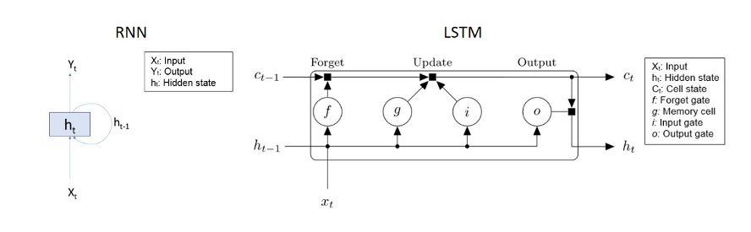
Long Short Term Memory Networks
What is Long Short Term Memory Networks ?
Long short-term memory (LSTM) is an artificial recurrent neural network (RNN) architecture. LSTM has feedback connections. It can process not only single data points but also entire sequences of data .A common LSTM unit is composed of a cell, an input gate, an output gate and a forget gate. The cell remembers values over arbitrary time intervals and the three gates regulate the flow of information into and out of the cell.

Slide 9
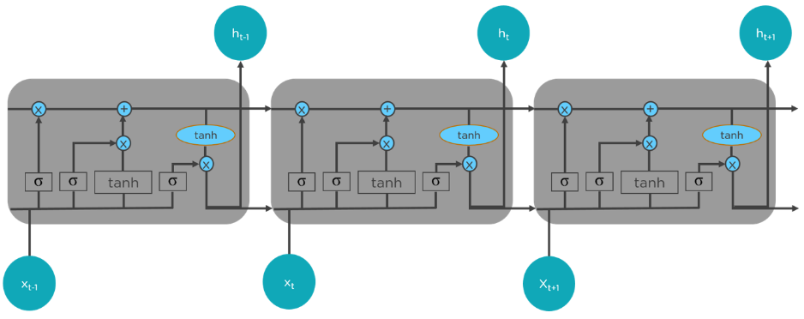
LSTMs Work In A Three-Step Process.
The first step in LSTM is to decide which information to be omitted from the cell in that particular time step. It is decided with the help of a sigmoid function. It looks at the previous state (ht-1) and the current input xt and computes the function.

Slide 10
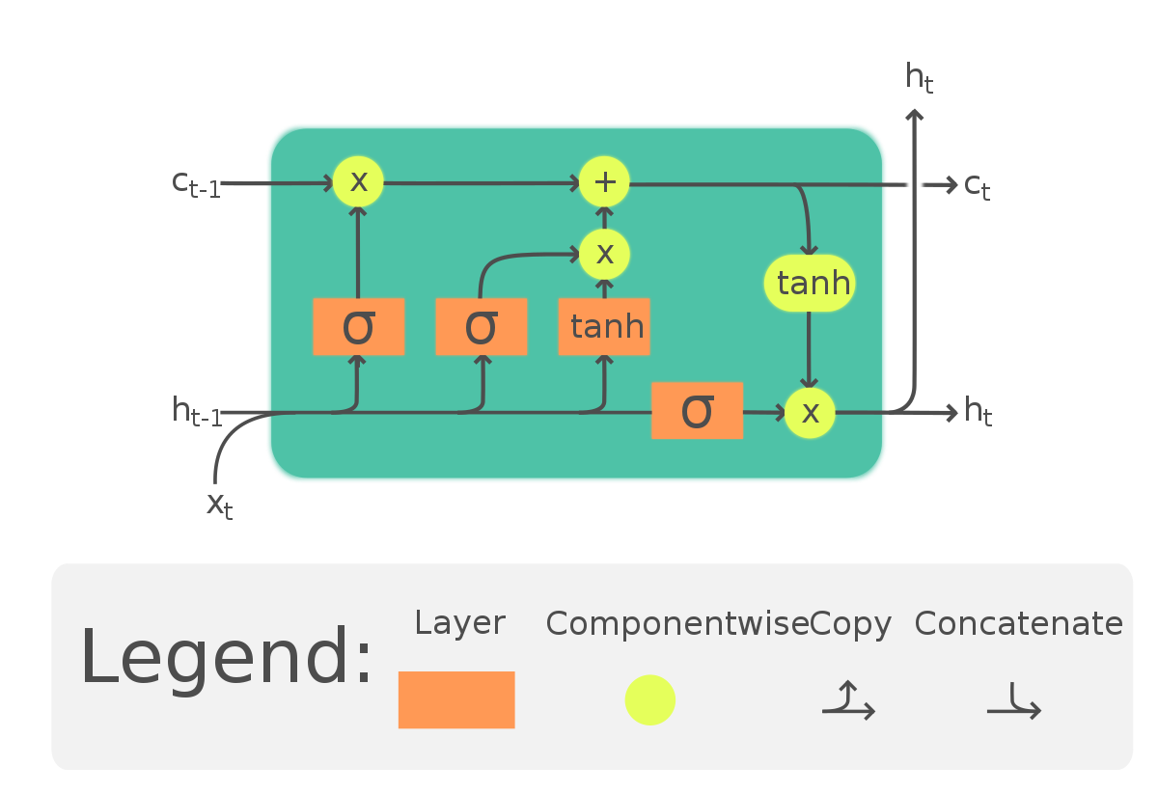
Other Steps
There are two functions in the second layer. The first is the sigmoid function, and the second is the tanh function. The sigmoid function decides which values to let through (0 or 1). The tanh function gives the weightage to the values passed, deciding their level of importance from -1 to 1
The third step is to decide what will be the final output. First, you need to run a sigmoid layer which determines what parts of the cell state make it to the output. Then, you must put the cell state through the tanh function to push the values between -1 and 1 and multiply it by the output of the sigmoid gate.

Slide 11

Long Short Term Memory Networks
Why Did We Use Long Short Term Memory Networks ?
LSTM networks are well-suited to classifying, processing and making predictions based on time series data, since there can be lags of unknown duration between important events in a time series. LSTMs were developed to deal with the vanishing gradient problem that can be encountered when training traditional RNNs. Relative insensitivity to gap length is an advantage of LSTM over RNNs .

Slide 12
Dataset and Dataset Format
The dataset contains two files about stock information of Google. One of the files contains train data and the other file contains test data.
The dataset contains these values:
Date: Date of the stock data
Open: Opening price of the stock
High: Highest price of the stock in that day
Low: Lowest price of the stock in that day
Close: Closing price of the stock
Volume: Volume traded in that day

Slide 13
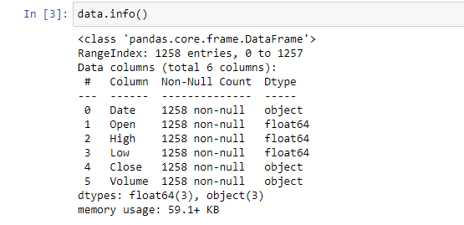
Train Data Information

Slide 14
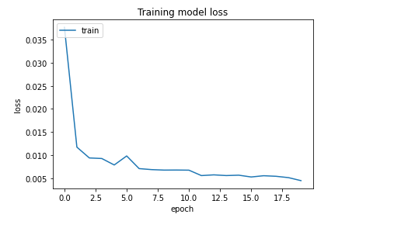
Training Model Loss

Slide 15
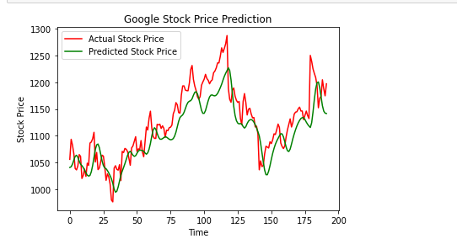
Stock Price Prediction

Slide 16
References
1- A Breakdown on How the Stock Market Works. (2021b, November 14). Investopedia. Retrieved January 1, 2022, from https://www.investopedia.com/articles/investing/082614/how-stock-market-works.asp
2- Li, K. (2021, December 22). Predicting Stock Prices Using Machine Learning. Neptune.Ai. Retrieved January 1, 2022, from https://neptune.ai/blog/predicting-stock-prices-using-machine-learning
3- Biswal, A. (2021, December 31). An Easy Guide to Stock Price Prediction Using Machine Learning. Simplilearn.Com. Retrieved January 1, 2022, from https://www.simplilearn.com/tutorials/machine-learning-tutorial/stock-price-prediction-using-machine-learning

